Slide 1


Amazon Ads- Optimizing Targeted Audience
Team 3 : Awesome Analysts of Albers (AAA)

Slide 2

Agenda
Introduction
Overall Recommendations
Data Cleaning and Profiling
Model approaches and results
Insights
New to Brand Reach and Optimal Bidding Strategy

Slide 3

Introduction
Developing audience targeting strategies that can significantly boost advertisers’ reach and engagement, leading to more effective and efficient marketing efforts.
Goal
Maximize Viewable Impressions and Clicks
Maximize New To Brand Reach
Optimal Bidding Strategy
Notes:
develop advanced audience targeting strategies that can significantly boost advertisers' reach and engagement, leading to more effective and efficient marketing efforts.

Slide 4
Overall Recommendations
Prioritize Weekends & Specific Months
Amongst Feb, Mar, Apr, May focus on advertising campaigns on weekends and during February and March
Refine Audience Targeting for maximum Reach
Categories : Women's Running Shoes, Foundation Makeup, Sheet and Pillowcase Sets
Slots: Desktop and mobile app.
Refine Audience Targeting for maximum NTB (New-to-Brand) Reach
Categories : Women's Running Shoes, Foundation Makeup, and Sheet and Pillowcase
Slots : Mobileapp / Mobileweb
Monitor & Adapt (monitor campaign performance) for any changes in future.
Limitations
There could be changes in optimal bidding and campaign performance based on external factors like economy, future target audience likings, future and historical data.
Notes:
Model Selection:
Use RandomForestRegressor for predicting impressions, clicks, and NTB reach due to its better performance.
Pay attention to features like clicks, placement slots, and temporal factors in the models.
Temporal Strategies:
Run campaigns in February and March for higher impressions and clicks. - holidays like valentine day, president , march had spring sales
Prioritize weekends for campaigns to maximize impressions and clicks.
Avoid Thursdays and mid-week days for campaign activities.
Bidding Strategy:
Develop bidding strategies with RandomForestRegressor model, considering clicks, targeting categories, placement slots, and temporal factors.
Adjust bids based on predicted impressions and clicks for cost-effectiveness.
Conclusion: By using RandomForestRegressor model insights, advertisers can optimize audience targeting, improve bidding strategies, and enhance overall campaign performance, leading to greater advertiser satisfaction and NTB reach.

Slide 5
Data cleaning And Profiling
Dataset Integration: Merged datasets, removed duplicates by date.
Numerical Features: Filled missing sales/orders with 0.
Categorical Features: Filled missing 'vertical'/'sub_vertical' with 'Unknown', applied one-hot encoding to extract features.
Date Feature: Extracted 'Month' and 'Day' from 'hit_day_utc'.
Note: Data is from Feb to May (we don't have complete data for month of May)
Notes:
Dataset Integration: Merged both the given datasets and deduplicated records based on date.
Numerical Features:
Replaced missing values in the sales/orders numerical columns with 0, based on the assumption that a blank signifies no items sold or ordered.
Categorical Features:
Replaced missing values in 'vertical' and 'sub_vertical' with 'Unknown'.
One-hot encoding for each feature extraction
Date Feature: Extracted 'Month' and 'Day' after parsing 'hit_day_utc' into a consistent date format.
Note: We don't have complete data for month of May

Slide 6
Model And Evaluation Metrics Used
Evaluation Metrics
Mean Absolute Error (MAE) - Average error between actual vs predicted
Mean Squared Error (MSE) - Like MAE, but squares errors before averaging.
Evaluation Metric R-squared (R²)-
How well our predictions match the actual data between 0 to 100%
Model Approaches
Gradient Boosting Regressor - Adds new decision models to correct errors made by existing models
Random Forest Regressor - Builds multiple decision independently on random subset and averages
Note: For detailed definitions consider checking the documentation in Appendix
Notes:
We decided to go ahead with regression model to predict impressions and then use it to optimize audience targeting.
Mean Absolute Error (MAE):-
Definition: It tells you how far your predictions are from the actual values on average.
Mean Squared Error (MSE):-
Definition: It shows how much your predictions differ from the actual values giving more weight to bigger mistakes.
Evaluation Metric R-squared (R²):-
Definition: It tells you how well your model's predictions match the actual data,
R-squared (R2) is defined as a number that tells you how well the independent variable(s) in a model explain the variation in the dependent variable. It goes from 0 to 1, where 1 indicates a perfect fit of the model to the data.
This tells us how well our predictions match the actual data. It's like a percentage score: 100% means perfect predictions, while 0% means our model is no better than guessing the average.
Random Forest Regressor: Think of a random forest as a group of independent graders. Each grader (decision tree) grades the homework independently and doesn't learn from the mistakes of others. At the end, you combine all the grades to get the final score by averaging them. This method helps to reduce the impact of any one grader's mistakes by using the collective wisdom of the group.
Gradient Boosting Regressor: Imagine you have a team of graders who work sequentially. The first grader gives the initial grades. The second grader then focuses on correcting the mistakes made by the first grader. The third grader corrects the mistakes of the first two graders, and so on. This way, each grader builds on the work of the previous ones, progressively improving the accuracy of the final grade. This process is called "boosting."
Gradient Boosting:
Gradient Boosting builds trees sequentially, where each new tree corrects errors made by the previous ones.
It is an additive model, meaning it adds new models to correct errors made by existing models.
It typically uses shallow trees as base learners, often decision trees with a depth of 1 to 5.
Gradient Boosting can overfit if the number of trees is too large or if the learning rate is too high.
Random Forest:
Random Forest builds multiple decision trees independently and combines their predictions through averaging or voting.
It trains each tree on a random subset of the data (bootstrapped sample) and a random subset of the features.
It can handle a large number of features and is less prone to overfitting compared to Gradient Boosting.
Random Forest can be parallelized as each tree can be trained independently.

Slide 7
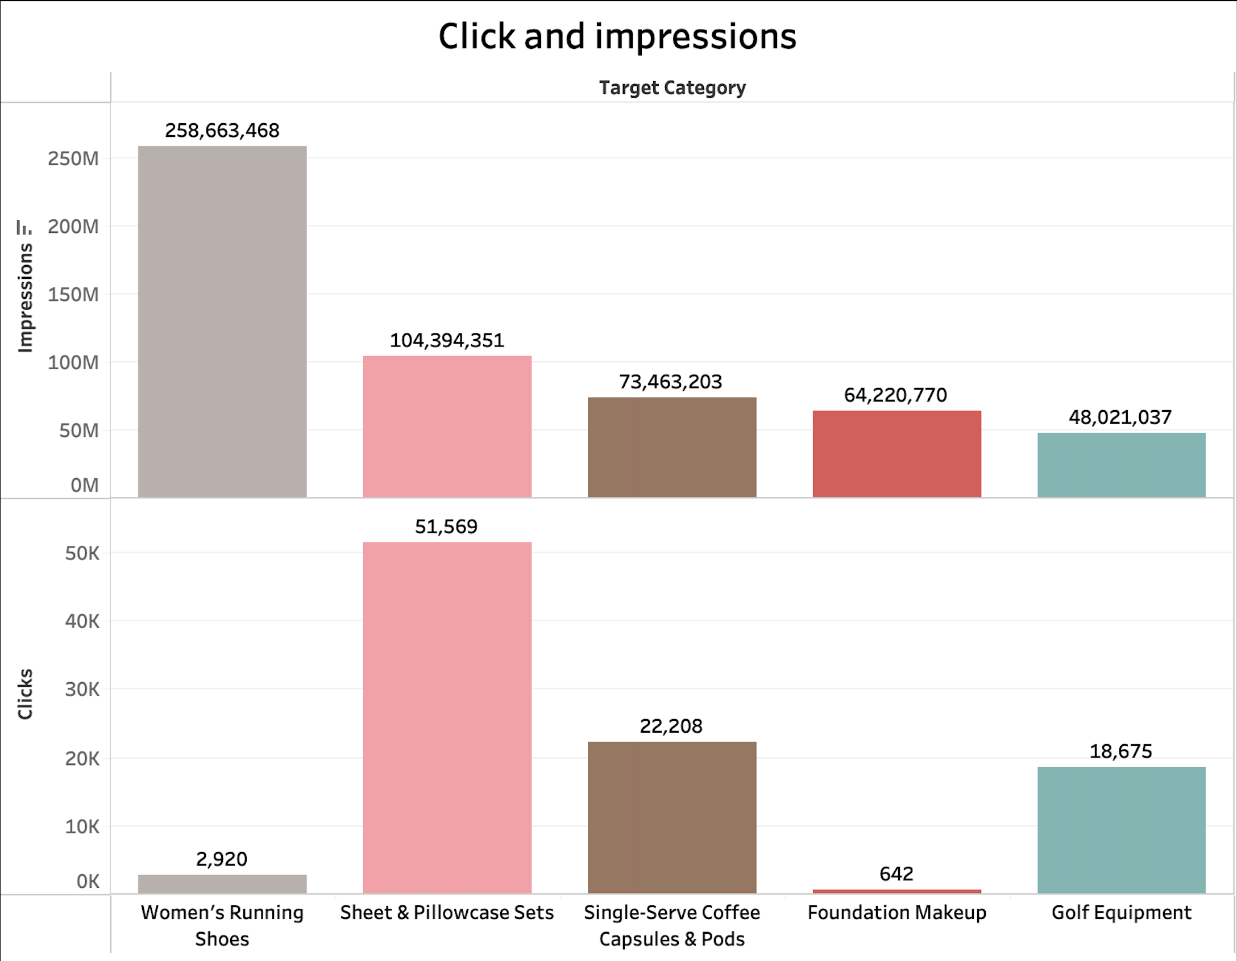
Preliminary Analysis
Notes:
Moderate Positive Correlations:
impressions and clicks have a moderate positive correlation (0.32), suggesting that more impressions tend to lead to more clicks, but the relationship is not as strong as some others.
This is just a preliminary EDA for categories and later in our modeling approaches we will consider other features as well to see actual importance.

Slide 8
IMPRESSIONS

Slide 9
Targeting for maximum Impressions: Approach
Objective:-
Predicting features influencing Impressions on whole dataset
Model Selection:-
Model Used: Gradient Boosting Regressor
Parameters used and Target variable:-
Filter criteria: None
Target: Impressions
Features: clicks, placement slot, targeting secondary, vertical, sub vertical, month, day

Slide 10
Targeting for maximum Impressions
FEATURES | Feature Importance Results( In decreasing order)
Placement slot | Offsite mobileapp Offsite Desktop
Targeting category:(Top 5) | Women's Running Shoes Foundation Makeup Soap Opera Sheet and Pillowcase Sets Single-Serve Coffee Capsules & Pods
Month | March February
Day of the Week | Sunday Saturday
Model Results | R-sq = 64.45% MAE = 1,252.09 MSE = 5,092,641.23

Slide 11
Optimized targeting for viewable Impressions
 | Approach 1 | Approach 2
Objective | Predicting features influencing impressions where some products were sold from views | Predicting features influencing impressions where there has been some clicks
Model Selection | Random Forest Regressor (better R-sq and less error) than Gradient Boosting | Random Forest Regressor (better R-sq and less error) than Gradient Boosting
Dataset Filter | view_attributed_units_sold > 0 (blanks treated as 0) | clicks > 0
Target | Impressions | Impressions
Features | clicks, placement slot, targeting secondary, month, day | clicks, placement slot, targeting secondary, month, day
Notes:
Say why units sols over orders as number of units sold > orders
Approach 1
Objective:-
Predicting features influencing impressions where there has been some products sold from views
Model Selection:-
Model Used: Gradient Boosting Regressor
Parameters used and Target variable:-
Filter criteria: Subset with view_attributed_units_sold >0
Target: 'impressions’
Features: ‘clicks’, 'placement_slot’, 'targeting_secondary’, 'vertical’, 'sub_vertical’, 'month’, 'day'
Approach 2
Objective:-
Predicting features influencing impressions where there has been some clicks
Model Selection:-
Model Used: Random Forest And Gradient Boosting Regressor
Model Chosen: Random Forest Regressor (better R-sq and less error)
Parameters used and Target variable:-
Filter criteria: Subset with clicks >0
Target: 'impressions’
Features: ‘clicks’, 'placement_slot’, 'targeting_secondary’, 'month’, 'day'

Slide 12
Optimized targeting for viewable Impressions
Feature Importance Results(In Decreasing order )
FEATURES | Dataset with View attributed units sold > 0 | Dataset with Clicks > 0
Placement slot | Mobile App Mobile Web | Offsite Desktop
Targeting category:(Top 5) | Women's Running Shoes Foundation Makeup Soap Opera Sheet & Pillowcase Sets Home & Kitchen | Sheet and Pillowcase Sets Women's Running Shoes Kid's Electronics Single-Serve Coffee Capsules & Pods Foundation Makeup
Month | February March | February March
Day of the Week | Sunday Saturday | Sunday Saturday
Model Results | R-sq = 84.60% MAE = 733.30 MSE = 3,243,257 | R-sq = 92.22% MAE = 542.57 MSE = 1,748,221
Notes:
R-squared (R2) is defined as a number that tells you how well the independent variable(s) in a model explain the variation in the dependent variable. It goes from 0 to 1, where 1 indicates a perfect fit of the model to the data.

Slide 13
CLICKS

Slide 14
Optimal targeting for maximum Clicks: Approach
Objective:-
Predicting important features influencing clicks
Model Selection:-
Model Used: Gradient Boosting Regressor
Parameters used and Target variable:-
Filter criteria: click are at least 1( 58674 records)
Target: Clicks
Features: impressions, placement_slot, targeting_secondary, vertical, sub_vertical, month, day
Notes:
Reasoning:
Along with giving the optimum target audience for impressions, we would also like to give the targeting strategy for clicks, as not all viewable impressions turn to clicks
Model Approach and Parameters
Both gradient boosting and random forest was performed and there wasn't much difference in error measures hence more advanced model gradient boosting is chosen.

Slide 15
Optimal targeting for maximum Clicks
FEATURES | Feature Importance Results( In decreasing order)
Placement slot | Offsite desktop Offsite mobile web
Targeting category:(Top 5) | Sheet and Pillowcase sets Single-Serve Coffee Capsules & Pods Pipe Fittings & Pipes Golf Equipment Bed Pillows & Positioners
Month | February March
Day of the Week | Saturday Sunday
Model Results | R-sq = 74.15% MAE = 1.22 MSE = 3.98

Slide 16
Key Insights: Top features for better reach
Below are the features to focus to maximize impressions and clicks based on previous approaches
Offsite Desktop
Offsite mobile app
Targeting Categories
Month:
March, February
Day of week:
Sunday and Saturday
Placement Slot
Impressions:
Women's Running Shoes
Foundation Makeup
Soap Opera
Sheet and Pillowcase Sets
Kid's Electronics
Clicks:
Sheet and Pillowcase sets
Single-Serve Coffee Capsules & Pods
Pipe Fittings & Pipes
Seasonality
Notes:
Now let’s focus on the Key Insights that will highlight the top features that maximize impressions and clicks based on previous approaches.
First feature is Placement slot.
Ads placed on mobile applications and mobile websites has been found to be the most effective for better reach.
The next feature is the targeting categories.
These are the top categories we saw regarding to the maximum impressions and clicks with having women’s running shoes and foundation makeup as top 2 categories for maximum impressions and sheet and pillowcase sets and single serve coffee capsules and pods as top 2 categories for maximum clicks.
The last feature is seasonality.
The achieved higher performance of the Ads has been found in February and march months and on the weekends.

Slide 17
NEW TO BRAND REACH

Slide 18
Maximizing “new to brand” reach: Approach
Objective:-
Predicting 'New To Brand' reach through impressions where some NTB products have been sold
Model Selection:-
Models Used: Random Forest and Gradient Boosting Regressor
Model Selected: Random Forest Regressor (less error and better R-sq)
Parameters used and Target variable:-
Filter criteria: ntb_view_attributed_units_sold is not ‘0’ and not in blank
Target: ‘impression’
Features: targeting_secondary, placement_slot, month, day
Notes:
The objective of this approach focuses on understanding and predicting the reach of NTB products through the number of impressions that lead to sales in order to have wider dataset as the data for sold items is more than for ordered items and same as for views is more than the clicks. This helps in targeting future ad campaigns more effectively.
(click on the mouse)
For this approach we tried two different models: first is Random forest regressor and second is Gradient booster regressor.
Random forest regressor was chosen over Gradient Boosting Regressor due to its lower error rates and better R-squared values, indicating higher accuracy and reliability in predictions.
(click on the mouse)
Let’s look over the parameter and the target variables:
The data is filtered by the data where at least one NTB product has been sold and removing any instances where there are no sales attributed to impressions.
The choice of 'impression' as the target variable aligns with the objective of maximizing reach.
The features 'targeting_secondary', 'placement_slot', 'month', and 'day' are critical for understanding the context and conditions under which ads perform the best, helping in fine-tuning ad placements and timings for better NTB reach.

Slide 19
Maximizing “new to brand” reach
Feature Importance Results
FEATURES | Feature Importance Results( In decreasing order)
Placement slot | Offsite mobileapp Offsite mobileweb
Targeting category:(Top 5) | Women's Running Shoes Foundation Makeup Sheet and Pillowcase Sets Home & Kitchen Oral Care Products
Month | March February
Day of the Week | Sunday Saturday
Model Results | R-sq = 79.24% MAE = 904.47 MSE = 4,553,859
Notes:
Lets summarise the results for important features
We have found that these are the most important, with the highest impact and most effective features contributing to the prediction of NTB reach, ranked by their significance:
For the placement slots, Ads placed on mobile apps and on mobile web have the highest impact.
Prioritizing products of the targeting categories such as Women’s running shoes, foundation makeup, sheet and pillowcase, oral care products and soap opera in ad campaigns can significantly enhance NTB reach.
Ads run during the months of February and March and weekends show higher performance in terms of NTB reach. This seasonal trend and having focus on these days can also guide the timing of ad campaigns to maximize effectiveness and can yield better results.
An R² value of 79.24% suggests that the model's features explain approximately 79.24% of the variance in NTB products that are sold. This high R² value indicates a strong predictive power of the model.
Having MAE of somewhat 900 shows that the predictions for NTB reach deviate from the actual reach by 1085 impressions and MSE value suggests that the average squared error between the predicted and actual NTB reach is over 4 hundred K impressions squared.
Larger errors are disproportionately penalized due to the squaring of differences. This could indicate that while most predictions might be close, there are a few instances with significant errors.
Now I will hand it over to Ming-yeh to explain the Optimal bidding strategy.

Slide 20
OPTIMAL BIDDING

Slide 21
Optimal Bidding Strategy: Approach
Objective:- ​
Predicting features for optimal bidding through maximum impressions with at least one click.
Increased bidding on a combination of these top features based on importance and applied on Adjusted Cost to see difference
​
Model: Random Forest Regressor Filter criteria: Click is > 0 Target: Impressions Features: 'Clicks', 'targeting_secondary', 'placement_slot', 'month', 'day' | Results: R-sq = 92.18 % MAE = 542.57 MSE = 174,221

Slide 22
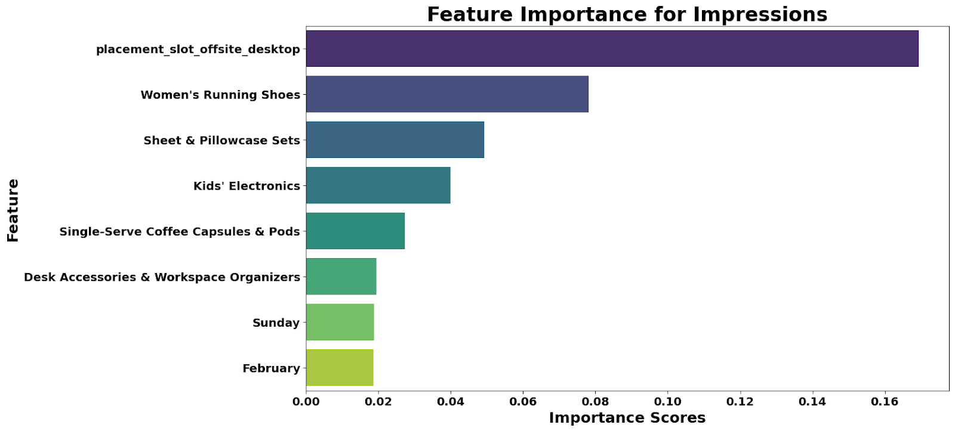
Features To Consider for Bidding
Note: For detailed analysis consider checking the documentation in Appendix

Slide 23
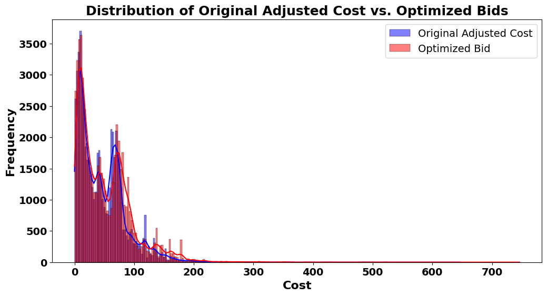
Bidding Strategy Implementation
Incrementing Adjusted Cost based on feature Importance:
Placement Slot: +10% for offsite desktop
Top 5 Categories:
+5%, 4%, 3%, 2%, 1%
Month: +5% for February
Day: +5% for Sunday

Slide 24
Thank you!
Q & A

Slide 25
Appendix
Submitted document and code in Assignment to supplement this presentation.
Documentation link

